Slide 1
Dynamic Programming
Subhashis Majumder
Prof. & HoD, CSE; Dean UG

Slide 2
Main facets of
Dynamic Programming (DP)
Has similarity with Divide and Conquer (D & C)
D & C partitions problems into independent subproblems, solves them recursively, then combines the solutions
DP is applicable when the sub-problems are dependent.
DP will solve every subsubproblem only once and will save its answer in a table
DP is typically applied to optimization problems

Slide 3
The 4 Steps of DP
Characterize the structure of an optimal solution
Recursively define the value of an optimal solution
Compute the value of an optimal solution in a bottom-up fashion
Construct an optimal solution from already computed information

Slide 4
Problem – Matrix Chain Multiplication
Definition – A product of matrices is called fully parenthesized if it is either a single matrix or a product of 2 fully parenthesized matrix products
Eg. <A₁ A₂ A₃> can be either
((A₁ A₂)A₃) or (A₁ (A₂ A₃))
Likewise <A₁ A₂ A₃ A₄> can be
i) (((A₁ A₂)A₃)A₄)
ii) ((A₁(A₂A₃))A₄)
iii) (A₁((A₂A₃)A₄))
iv) (A₁(A₂(A₃A₄)))
v) (A₁A₂)(A₃A₄))

Slide 5
Important Fact
The method of parenthization has a dramatic impact on the cost of evaluation of the product
Consider the simplest Matrix Mult. Algorithm
matrix_Mult(A, B)
Assert columns[A] = rows[B]
for i = 1 to rows[A]
  for j = 1 to columns[B]
  do C[i, j] = 0
  for k = 1 to columns[A]
  do C[i, j] <- C[i, j] + A[i, k] *B[k, j]
return C

Slide 6
Illustration of Fact with a Typical Example
Number of scalar multiplications done by the algorithm = rows[A]*columns[A]*columns[B]
If A = p x q matrix and B = q x r matrix, total run-time = total number of scalar mult. = pqr
Let A₁ = a₀ x a₁ (say 5 x 40)
A₂ = a₁ x a₂ (say 40 x 10)
A₃ = a₂ x a₃ (say 10 x 100)
((A₁ A₂)A₃) will need a₀ a₁ a₂ + a₀ a₂ a₃
= 5.40.10 + 5.10.100 = 2,000 + 5,000 = 7,000 scalar mult.
(A₁ (A₂ A₃)) will need a₁ a₂ a₃ + a₀ a₁ a₃
= 40.10.100 + 5.40.100 = 40,000 + 20,000 = 60,000 scalar mult.

Slide 7
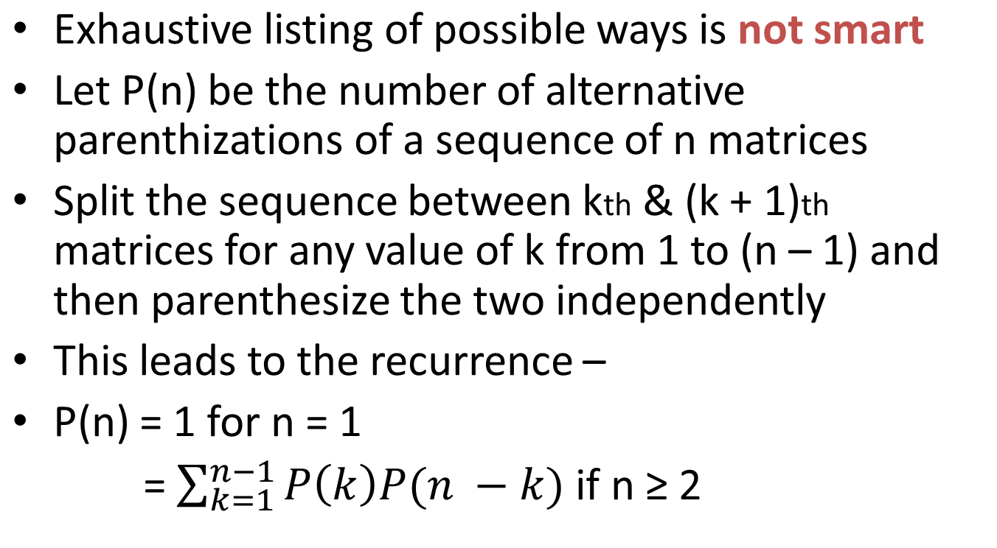
Counting Number of Parenthization

Slide 8
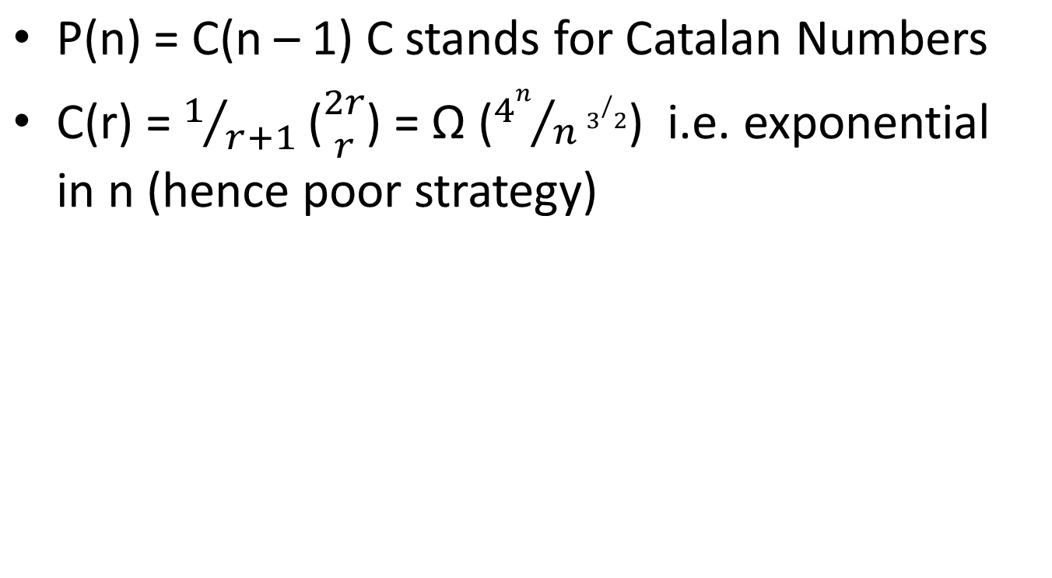
Solution of the Recurrence

Slide 9
STEP 1: Structure of an optimal parenthisation
Suppose an optimal parenthisation splits the sequence A₁, A₂ ….. A_{n} between A_{k} & A_{k+1} for 1 ≤ k ≤ n
So for some value of k, compute A_{1……..K} , and A_{K+1….n}, then multiply them to get the final result.
(A_{1……..K} denotes A₁ x A₂ x ….. x A_{k})
Key observation – Parenthisation of the prefix sub-chain A₁, A₂ ….. A_{k} is also optimal (Prove it - By contradiction)
As total cost = cost of producing A_{1……..K} + A_{K+1….n} + Cost of multiplying them( each is independent term)
Similarly, A_{K+1 …}A_{n} also has Op. Parenthisation .
OPTIMAL SUBSTRUCTURE – NECESSARY (HALLMARK) for applicability of DP

Slide 10
STEP 2 Express the value of an optimal solution recursively in terms of optimal solution of sub problems
Sub-problem – minimum cost of parenthisation of A_{i}, A_{i+1……..} A_{j} for 1 ≤ i ≤ j ≤ n
Let m[i, j] = min. no. of scalar multiplications required for the sub-problem. So the cost of actual problem is m[1, n].
Results – Assuming dimensions of
A₁ to be P₀ x P₁
A₂ to be P₁ x P₂
so A_{i} to be P_{i-1} x P_{i}
We have m[i,i] = 0
m[i, j] = m[i, k] + m[k+1, j] + P_{i-1} P_{k} P_{j} i ≤ k < j
Assuming split around k
k has j – i possible values namely i, i + 1,………, j - 1
Let S[i, j] denote the value of k where the chain can be split.

Slide 11
A brute force methods using recursion will again be exponential.
3rd step – Computing the optimal cost
Observation – No of sub problem is relatively FEW.
One sub-problem for each choice of i and j from 1 ≤ i ≤ j ≤ n
{ (n – 1) + (n -2)+…………+1 } + n = Θ(n²)
Bottom-up Algorithm -
Maintain Auxiliary tables.
m[1, n] (Stores minimum value)
s[1, n] (Stores optimal split k)

Slide 12
MATRIX-CHAIN-ORDER(P)
n ← length[P] – 1
for i ← 1 to n
do m[i, i] ← 0
for l ← 2 to n
do for i ← 1 to n – l + 1
do j ← i + l - 1
m[i, j] ← ∞
for k ← i to j - 1
do q ← m[i, k] + m[k + 1, j] + P_{i-1}P_{k}P_{j}
if q < m[i, j], then
m[i, j] ← q
s[i, j] ← k
endif
Return m and s

Slide 13
 | 1 | 2 | 3 | 4 | 5 | 6
1 | 0
2 |  | 0 |  |  | m(2,5)
3 |  |  | 0
4 |  |  |  | 0
5 |  |  |  |  | 0
6 |  |  |  |  |  | 0

Slide 14
MATRIX-CHAIN-MULT(A, s, i, j)
If j > i, then
X ← MATRIX-CHAIN-MULT(A, s, i, s(i, j))
Y ← MATRIX-CHAIN-MULT(A,s, s(i, j) + 1, j)
return MatrixMult(X, Y)
else
return A
endif

Slide 15
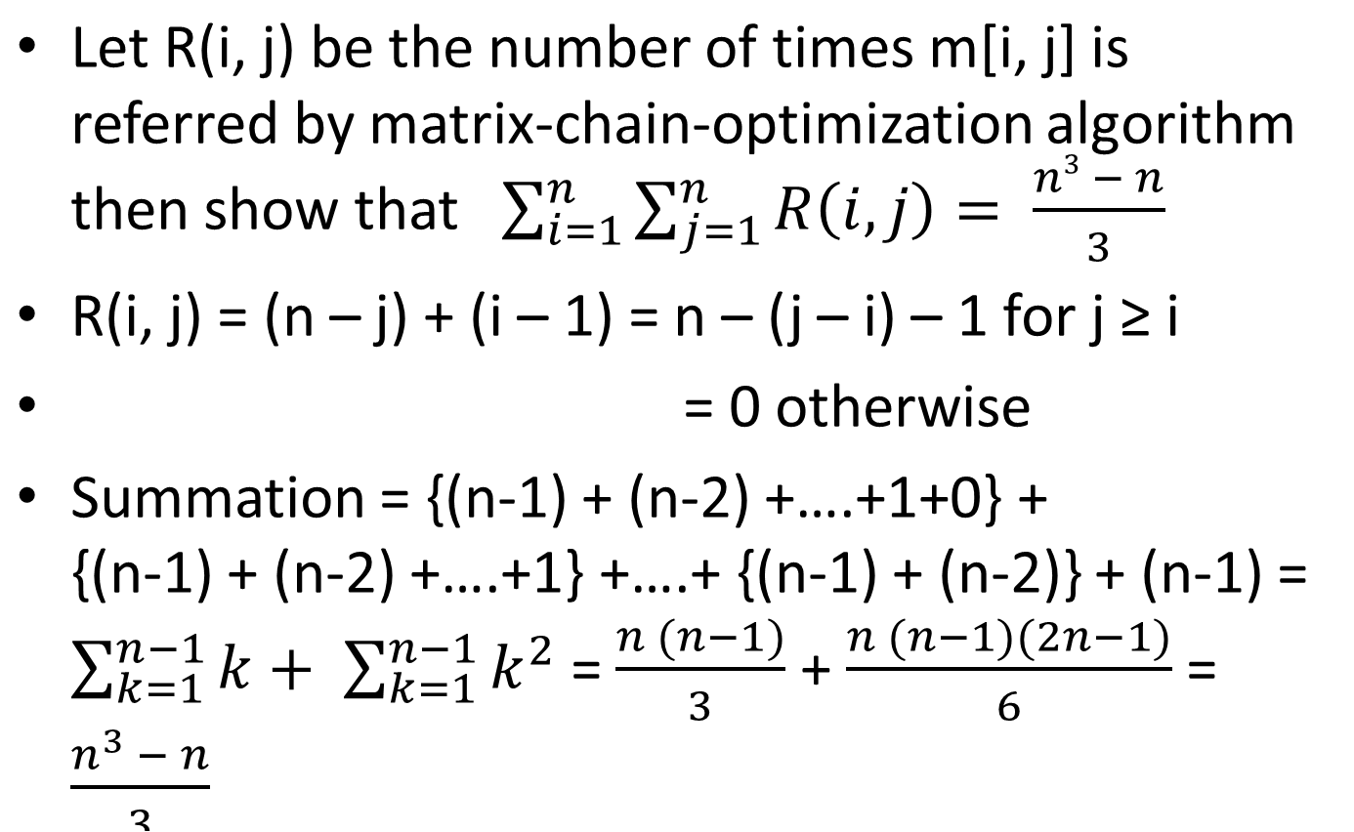
Problem from book

Slide 16
Longest Common Subsequence (LCS) Problem
Given X = <x₁, x₂, ……………., x_{m}>
and Z = <z₁, z₂, ……………., z_{k}>
Z is a subsequence of X if there exists a strictly increasing sequence <i₁, i₂, ….i_{k}> of indices of X, ϶ for all j = 1, 2, ….k, we have x_{ij} = z_{j}
Z = <B, C, D, B> is a subsequence of
X = <A, B, C, B, D, A, B>
So strictly increasing sequence is <2, 3, 5, 7>

Slide 17
LCS Problem
Given 2 sequences X = <x₁, x₂, ……………., x_{m}> and Y = <y₁, y₂, ……………., y_{n}>, find a maximum length common subsequence of X and Y.
Eg. X = <ABCDEFG>, Y = <BCEDGF>, then <BCDF>, <BCDG>, <BCEF> and <BCEG> are all LCS for these 2 sequences.
Brute force approach – Have to consider 2^{m} subsequences of X and 2^{n} subsequences of Y and hence exponential.

Slide 18
Natural Class of subproblems
Consider pairs of prefixes of both the sequences and identify the optimal substructure in this context
Theorem – If X = <x₁, x₂, …., x_{m}> and Y = <y₁, y₂, …., y_{n}>, and let Z = <z₁, z₂, …., z_{k}> be any LCS of X and Y. Then
1> If x_{m} = y_{n}, then z_{k}= x_{m} = y_{n}, and Z_{k-1} is an LCS of X_{m-1} and Y_{n-1}
2> If x_{m} ≠ y_{n}, then z_{k}≠ x_{m} implies Z is an LCS of X_{m-1} and Y
3> If x_{m} ≠ y_{n}, then z_{k}≠ y_{n} implies Z is an LCS of X and Y_{n-1}

Slide 19
Proof of 1>
To prove Z_{k-1} is an LCS of X_{m-1} and Y_{n-1}
Proof – Assume for contradiction that there exists another subsequence of length greater than that of Z_{k-1} . Let it be R. Then |R| > k – 1. However, then |Rz_{k}|> k , where Rz_{k} will be an LCS of X and Y, which contradicts our assumption.
Examples for case -
  1> X = ABCDE, Y = CBADE, so Z = ADE
  2> X = ABCDE, Y = CBACD, so Z = BCD as z₃≠ x₅
  3> X = ABCDE, Y = ABBEJ, so Z = ABE as z₃≠ y₅
  2 & 3> X = ABCDE, Y = BCDAJ, Z = BCD as z₃≠ x₅≠ y₅

Slide 20
Pseudo-code for LCS – array (m + 1) x (n + 1)
m <- length[X], n <- length[Y]
for i <- 1 to m
  do c[i, 0] <- 0
for j <- 0 to n
  do c[0, j] <- 0
for i <- 1 to m
  do for j <- 1 to n
  do if x_{i} = y_{j}
  then c[i, j] <- c[i - 1, j – 1] + 1
  b[i, j] <- “ ↖”
  else if c[i - 1, j ] >= c[i, j – 1]
  then c[i, j] <- c[i – 1, j]
  b[i, j] <- “↑”
  else c[i, j] <- c[i, j - 1]
  b[i, j] <- “←”
  Return c and b

Slide 21
An example – LCS is BCBA
Why not BCAB?
 |  | 0 | 1 | 2 | 3 | 4 | 5 | 6
 |  |  | B | D | C | A | B | A
0 |  | 0 | 0 | 0 | 0 | 0 | 0 | 0
1 | A | 0 | 0 ↑ | 0 ↑ | 0 ↑ | 1↖ | 1← | 1↖
2 | B | 0 | 1↖ | 1← | 1← | 1 ↑ | 2↖ | 2←
3 | C | 0 | 1↑ | 1↑ | 2↖ | 2← | 2↑ | 2↑
4 | B | 0 | 1↖ | 1↑ | 2↑ | 2↑ | 3↖ | 3←
5 | D | 0 | 1↑ | 2↖ | 2↑ | 2↑ | 3↑ | 3↑
6 | A | 0 | 1↑ | 2↑ | 2↑ | 3↖ | 3↑ | 4↖
7 | B | 0 | 1↖ | 2↑ | 2↑ | 3↑ | 4↖ | 4↑

Slide 22
All pair Shortest Paths
G = (V, E) is a weighted directed graph with weight function w: E → R.
Want to output a table so that the entry in u’s row and v’s column will be the weight of a shortest path from u to v.
If we use Dijkstra’s algorithm, and if min-priority queue is implemented
  i) as array, then O(V³ + VE) = O(V³)
  ii) as binary heap – O(VE lg V) (improvement for sparse graph)
  iii) Fibonacci heap – O(V²lg V + VE)

Slide 23
Other alternatives
If we use Bellman Ford algorithm – then advantage is that –ve weight cycles can now be present – for dense graphs O(V² E) = O(V⁴).
3 algortihms for APSP -
i) Matrix multiplication algorithm
ii) Floyd Warshal algorithm
iii) Johnson’s algo for sparse graphs
First 2 algorithms use adjacency matrices.

Slide 24
Starting Basics
Assume vertices are numbered 1, 2,…, n = |V|, so that input is a n x n matrix W representing the edge-weights of an n-vertex directed graph G = (V, E), W = (w_{ij})
w_{ij}= 0 if i = j
= ∞ if i ≠ j, (i, j) does not belong to E
= the weight of the directed edge (i, j), if i ≠ j
and (i, j) belongs to E

Slide 25
Some more trivia
Assume –ve weight edges are allowed, but no –ve weight cycles are allowed
Output is an n x n matrix D = (d_{ij}), where at termination the matrix becomes d_{ij} = ᵟ(i, j)
Also will compute predecessor matrix π = (π_{ij}), where π_{ij} = nil if either i = j, or there is no path from i to j, otherwise it is the predecessor of j in some shortest path from i

Slide 26
Predecessor Subgraphs
The subgraph induced by the ith row of the π matrix is the shortest paths tree with root i
For each vertex i belonging to V, we define the predecessor subgraph of G for i (root) as –
G_{π,i} = (V _{π,i}, E _{π,i}) where
V _{π,i} = {j belongs to V : π_{ij} ≠ nil} ᴜ {i} and
E _{π,i} = {(π_{ij} , j) : j belongs to V _{π,i} – {i}}
G_{π,i} gives a shortest paths tree with i as root

Slide 27
Procedure: PrintAllPairShortestPaths(π, i, j)
if i = j
then print I
else if π_{ij} = nil
then print “no path from i to j”
else PrintAllPairShortestPaths(π, i, π_{ij} )
print j
Dynamic Programming algo based on Matrix Multiplication takes O(V³ logV) time
However Floyd-Warshal algo takes O(V³) time

Slide 28
Floyd-Warshal Algorithm
Assumption - No negative cycles are present
Structure of a Shortest Path –
Intermediate vertex of a simple path p = <v₁, v₂, …v_{l}> is any vertex p other than v₁ or v_{l} , i.e., any vertex from the set <v₂, v₃, …v_{l-1}>
Let V = {1, 2, ….., n}, consider {1, 2, …, k}, a subset of V.
For any pair i, j ϵ V, consider paths from i to j where intermediate vertices are drawn from {1, 2, …, k} and let p be a minimum weight simple i->j path from among them

Slide 29
F-W algo contd.
Floyd Warshal algo exploits whether vertex k is present or not as an intermediate vertex of p.
If k is not an intermediate vertex of p, then a shortest path from i to j with all intermediate vertices in {1, 2, …, k – 1} is also a shortest path with intermediate vertices in the set {1, 2, …, k}
Otherwise if k is an intermediate vertex of path p, then we break down p into 2 subpaths p1 from i k and p2 from k j where p1 and p2 are paths with all intermediate vertices from {1, 2, …, k – 1}

Slide 30
Let d_{ij} ^{(k)} = shortest path distance from i to j with all intermediate vertices in the set {1, 2, …, k},
When k = 0, there is no intermediate vertices at all
Hence d_{ij} ⁽⁰⁾ = w_{ij} (such a path has at most one edge)
Recursive solution to all-pair-shortest-path-problem
d_{ij} ^{(k)} = w_{ij} if k = 0
min(d_{ij} ^{(k - 1)} , d_{ik} ^{(k-1)} + d_{kj} ^{(k-1)} )
The matrix D ^{(n)} = d_{ij} ^{(n)} = ᵟ(i, j) for all i, j ϵ V

Slide 31
Computing Shortest Path Bottom-up
Floyd-Warshal(W)
n <- rows[W]
D ⁽⁰⁾ <- W
for k <- 1 to n
do for i <- 1 to n
do for j <- 1 to n
do d_{ij} ^{(k)} = min(d_{ij} ^{(k - 1)} , d_{ik} ^{(k-1)} + d_{kj} ^{(k-1)} )
return D ^{(n)}
Complexity – O(n³)

Slide 32
Constructing a Shortest Path
Construct a matrix Π while computing D, like π⁽⁰⁾, π⁽¹⁾, …, π^{(n)} = Π, where
π_{ij}^{(k)} is defined as predecessor of vertex j on the shortest path from i to j with all intermediate vertices in the set {1, 2, …, k}
π_{ij}⁽⁰⁾ = nil if i = j or w_{ij}= ∞
= i if i ≠ j and w_{ij} < ∞
Now, for k ≥ 1, if we choose a path going through k while going from i to j where k ≠ j, choose the predecessor of j in path from k to j with vertices from {1,2, …, k -1}

Slide 33
Final Predecessor Expression
π_{ij}^{(k)} = π_{ij}^{(k-1)} if d_{ij}^{(k - 1)} ≤ d_{ik} ^{(k-1)} + d_{kj} ^{(k-1)}
= π_{kj}^{(k-1)} if d_{ij}^{(k - 1)} ≥ d_{ik} ^{(k-1)} + d_{kj} ^{(k-1)}
Transitive Closure of G is called G* = (V, E*)
  where E* = {(i, j): there is a path p from i to j in G}
We can give a O(n³) algorithm by assigning weight = 1to each edge of G and run Floyd Warshal algorithm.

